Slide 1

Neural Network on MNIST from Scratch - Various Activations

Slide 2
Reference
Youtube on Neural Network on MNIST
Youtube
Code

Slide 3
Warm Up

Slide 4
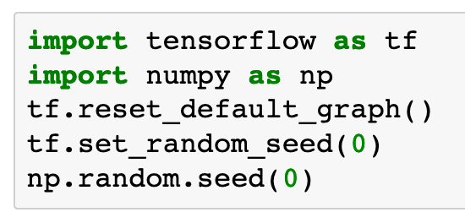

Slide 5
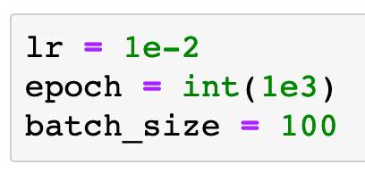

Slide 6
Data

Slide 7
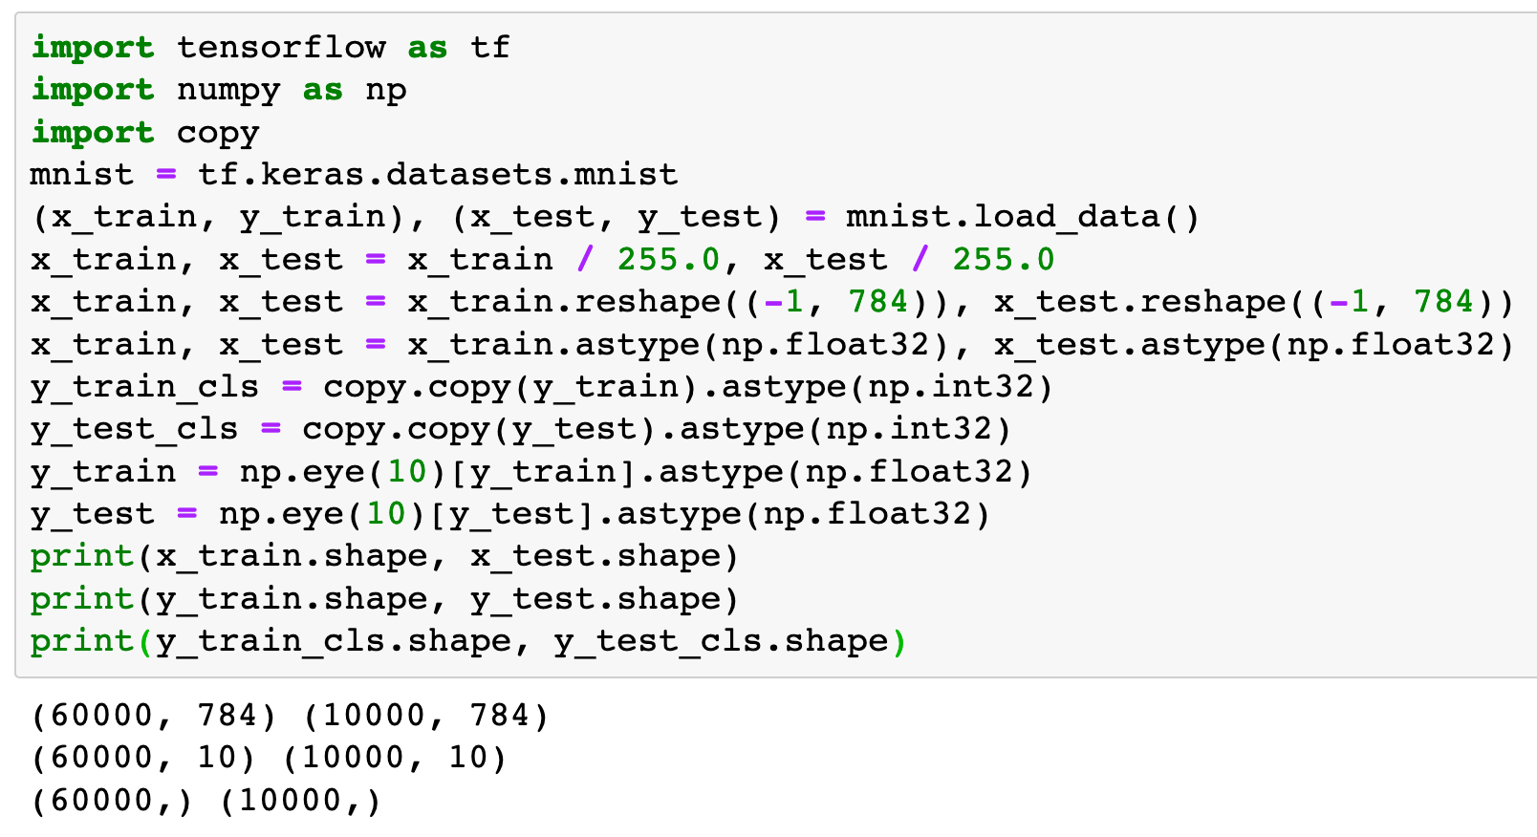

Slide 8
Graph

Slide 9
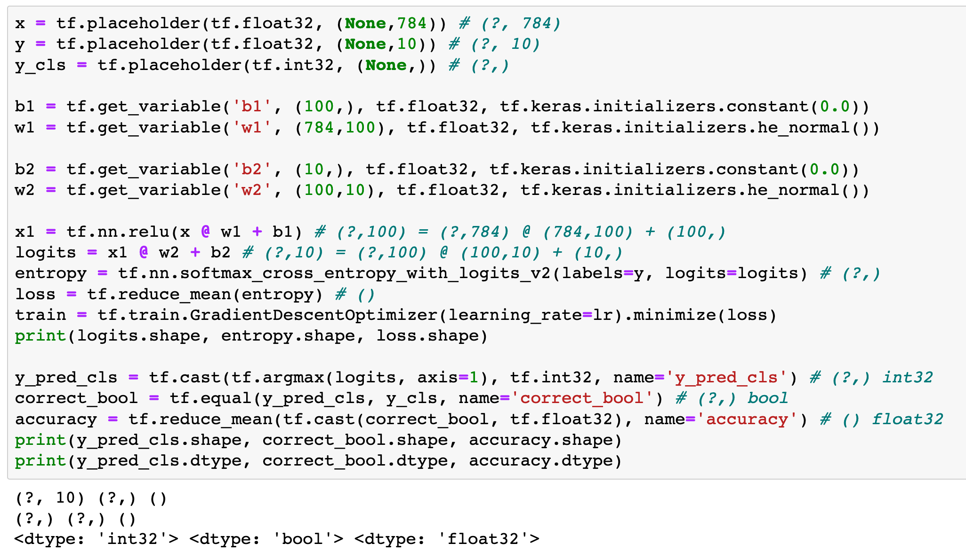
Previously

Slide 10
Previously

Slide 11
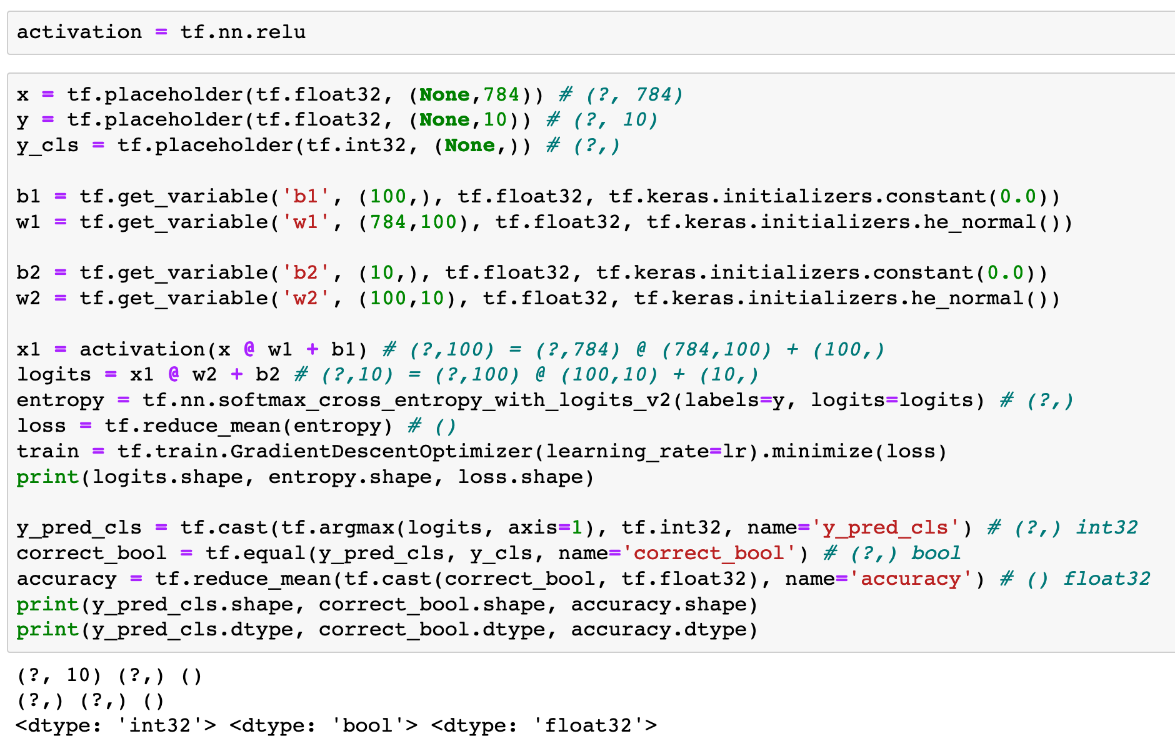
Now

Slide 12
Now

Slide 13
Now

Slide 14
Various Choices of activation

Slide 15
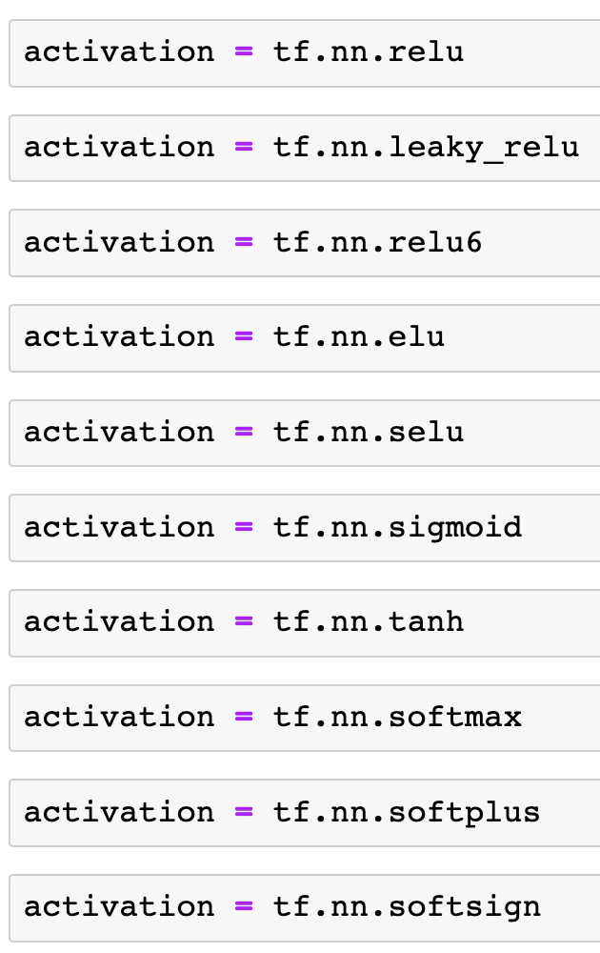


Slide 25
Session

Slide 26
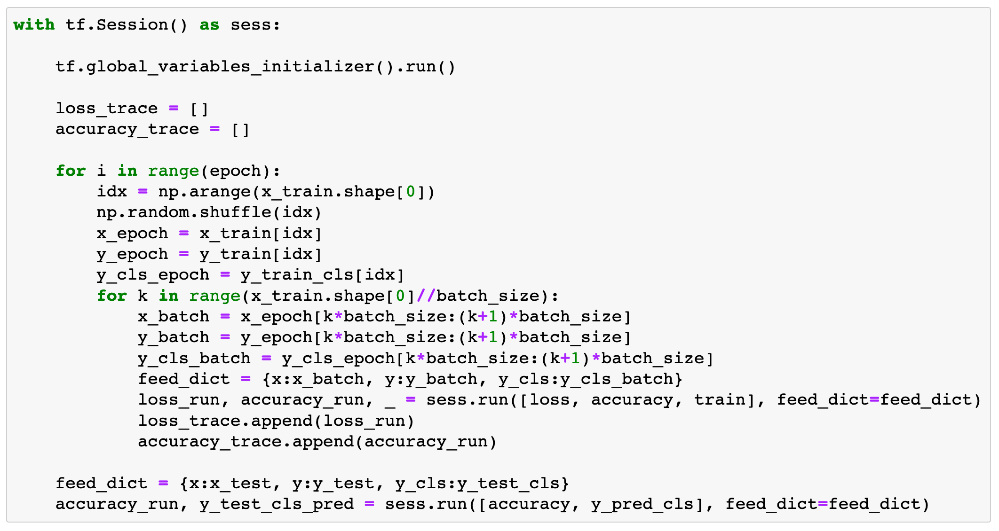

Slide 27
Report Result

Slide 28
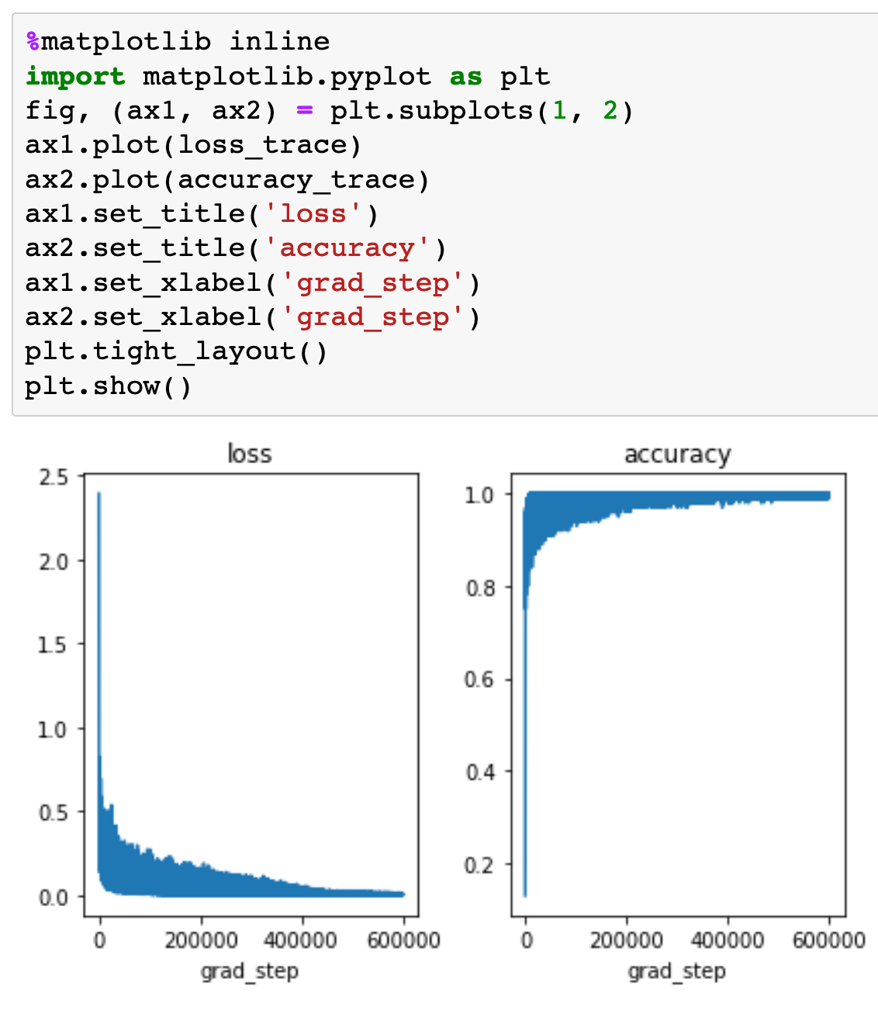
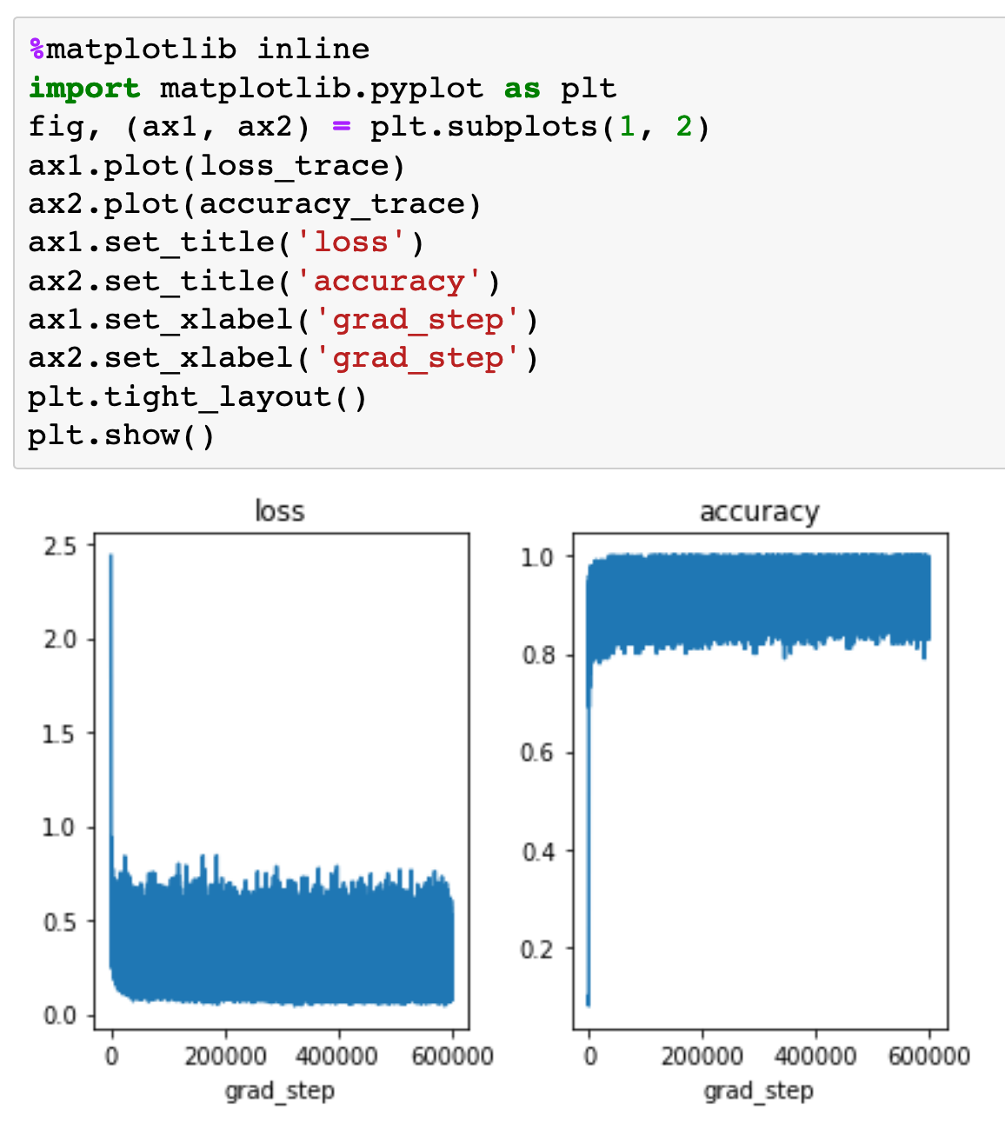

Slide 29
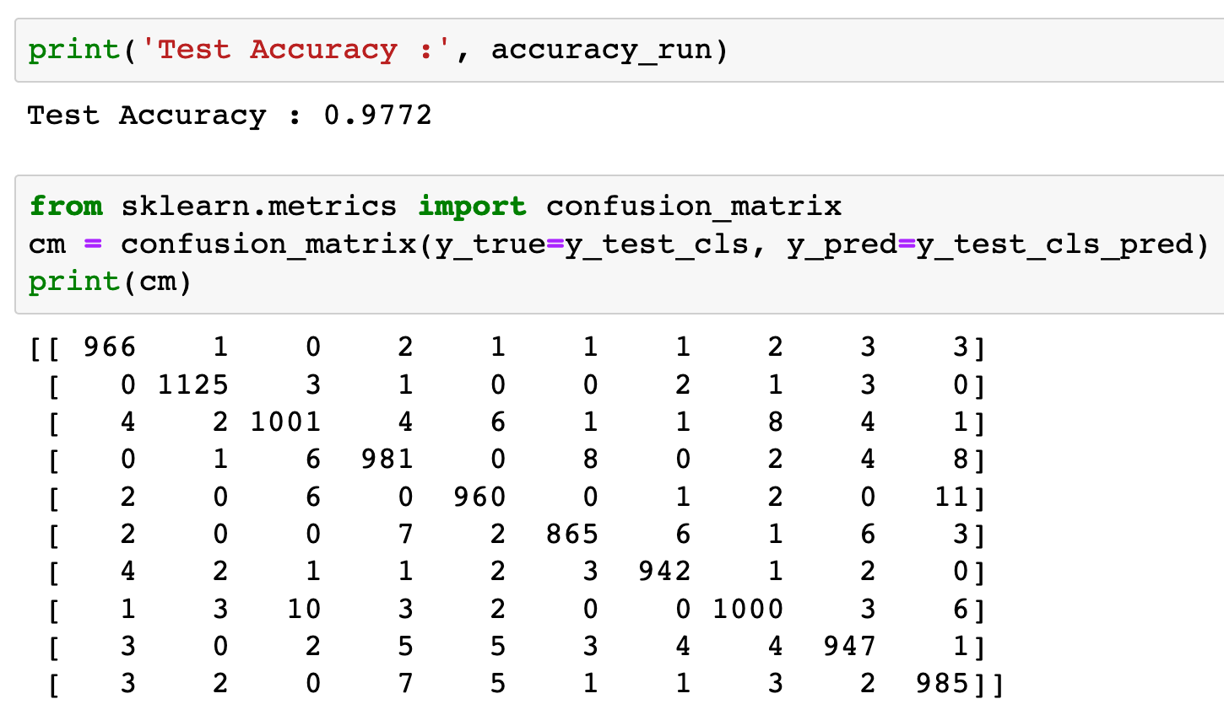


Slide 31
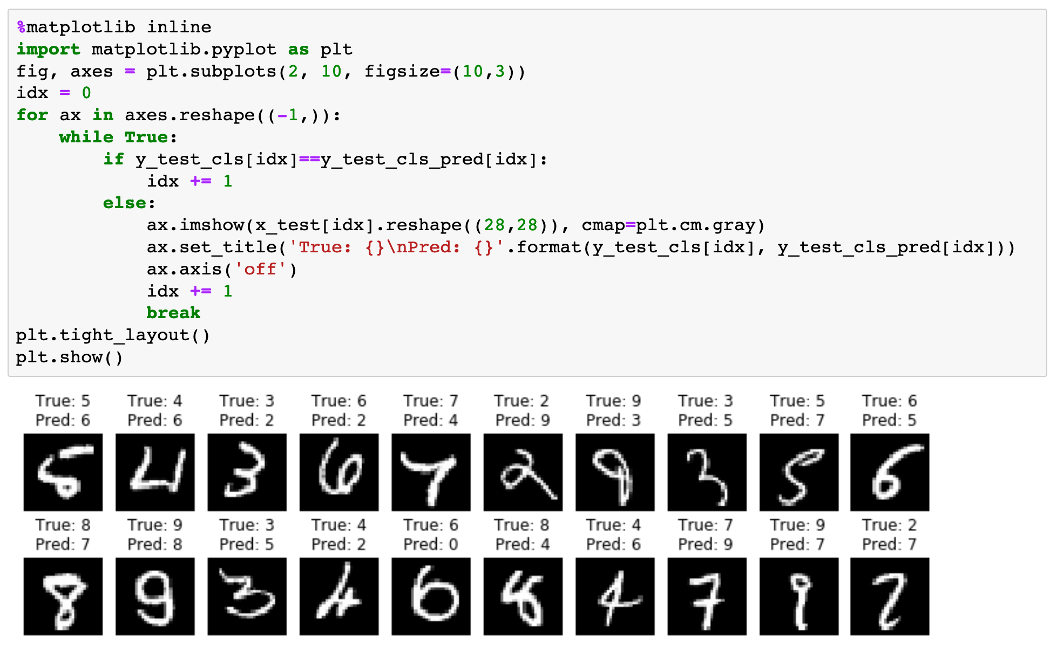

Slide 32
Test Accuracy for Various Choices of activation

Slide 33
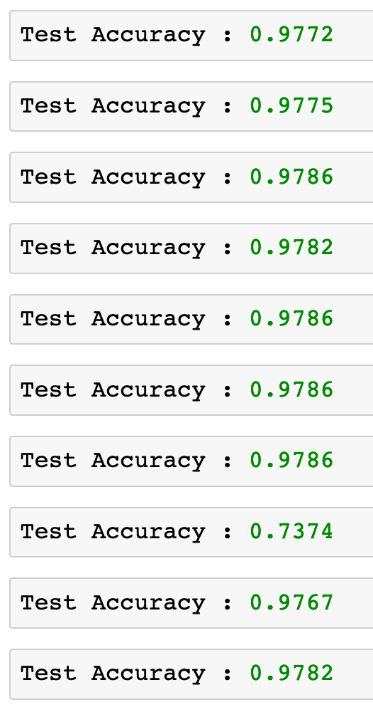

Slide 44
Now
Let’s Play with Code

